Slide 1
Compiler Lab Task

Slide 2
Problem-1
The following table contains a fixed set of Regular expression (RE) that you have to Evaluate:
Description | RE | Valid | Invalid
Character classes | [a-m]* | blackmail imbecile | above below
Negation of character classes | [^aeiou] | b c | a e
Exactly N times | [^aeiou]{6} | rhythm syzygy | rhythms allowed
Once or not at all | a(bc)?de | ade abcde | abc abcbcde
N.B. You must not use any built-in regular expression method or package.

Slide 3
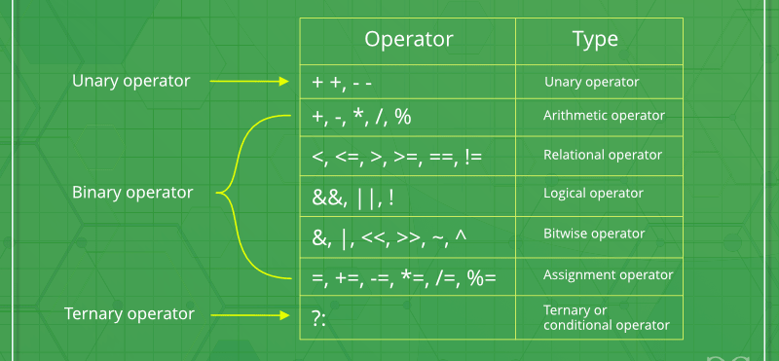
Problem-2
Design a Lexical Analyzer which can list the following tokens:
You will need to read a file named "input.c" to collect all chars.
For simplicity, input file will be a C program without headers and methods.
You can assume that, there will be a space after each keywords.

